Slide 1
Why we need Single Payer Medicare for All Now
www.michigan4singlepayer.org
https://www.facebook.com/M4SPH/
https://twitter.com/Medicare4AllMI

Slide 3
The Vision:
A country in which all people can get the care they need regardless of how much money they have, or do not have, as a right.

Slide 4
The Problem
The US spends far more than other industrialized countries on healthcare
But has far worse outcomes (life expectancy, infant mortality, maternal mortality)
The US is the only industrialized country without guaranteed universal healthcare of some kind.
Despite the ACA, 30 million Americans still uninsured (Source: Kaiser Family Foundation)
45,000 people a year die in the US due to lack of insurance (Source: Harvard Gazette)
Another 41 million are underinsured (cannot afford to use their insurance) (Source: Commonwealth Fund)

Slide 5
The Problem
Average Deductible now: $1350 (up 212% since 2008)
67% of bankruptcies are due to medical bills (source: American Journal of Health Policy)
~1 million Americans a year (source: Kaiser Family Foundation)
25% of Americans struggle to pay medical bills (including 20% of insured Americans)
42% of cancer patients lose all their assets within 2 years of diagnosis (Source: American Journal of Medicine)
Single largest category on GoFundMe is medical debt (over $1.5 billion / year) (Source: Business Insider)

Slide 6
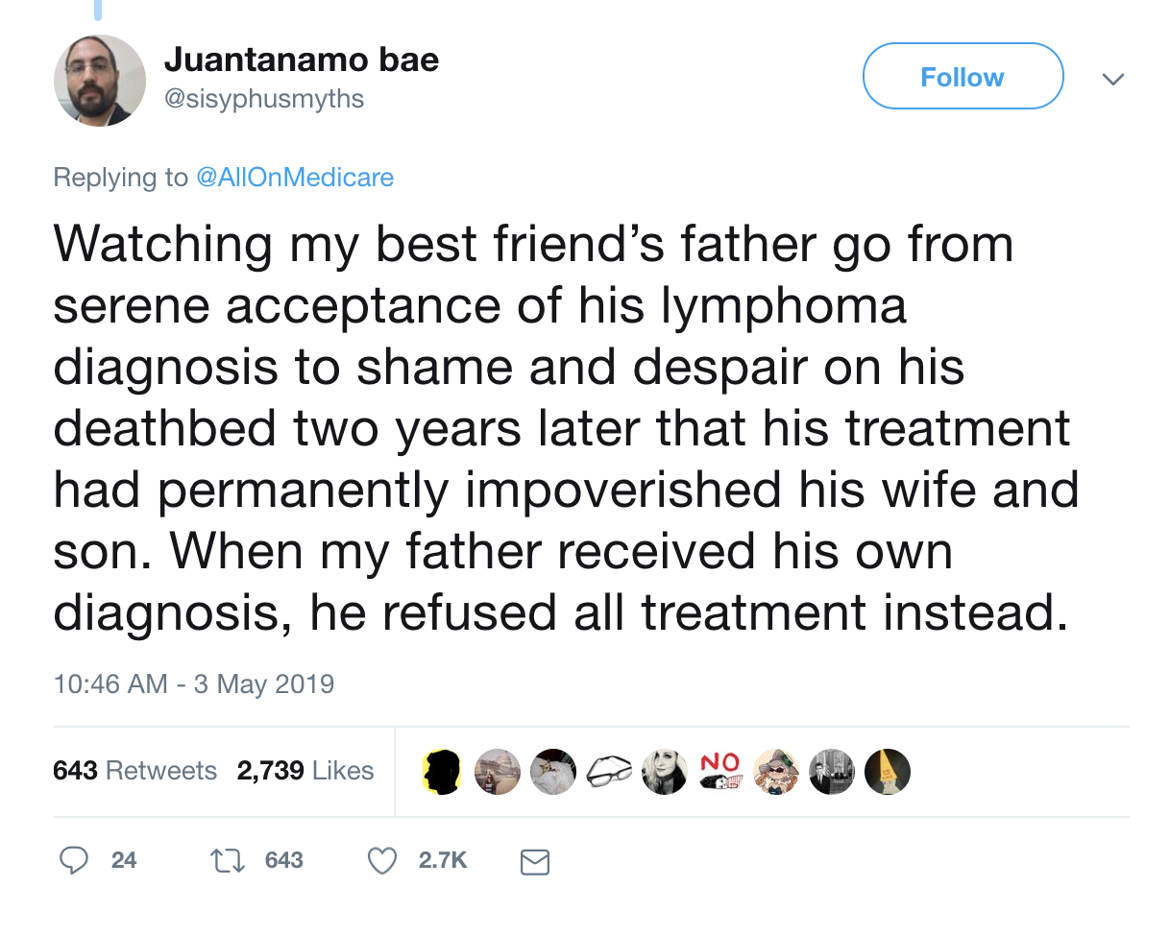
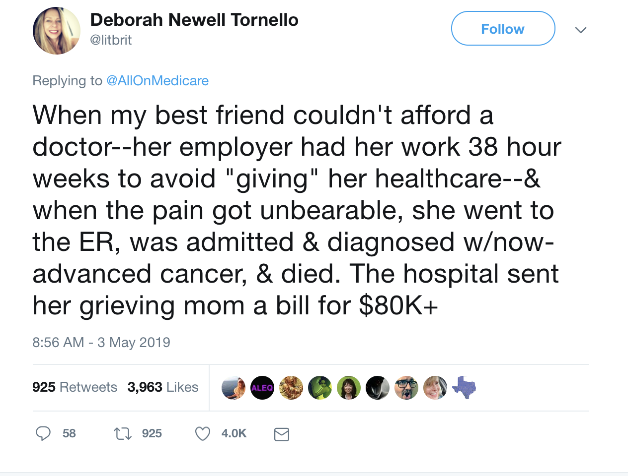
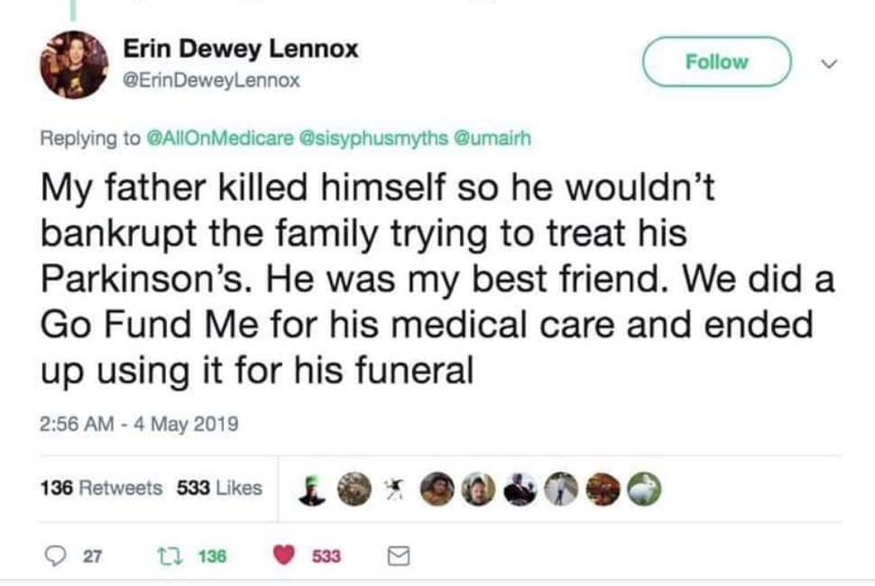

Slide 7
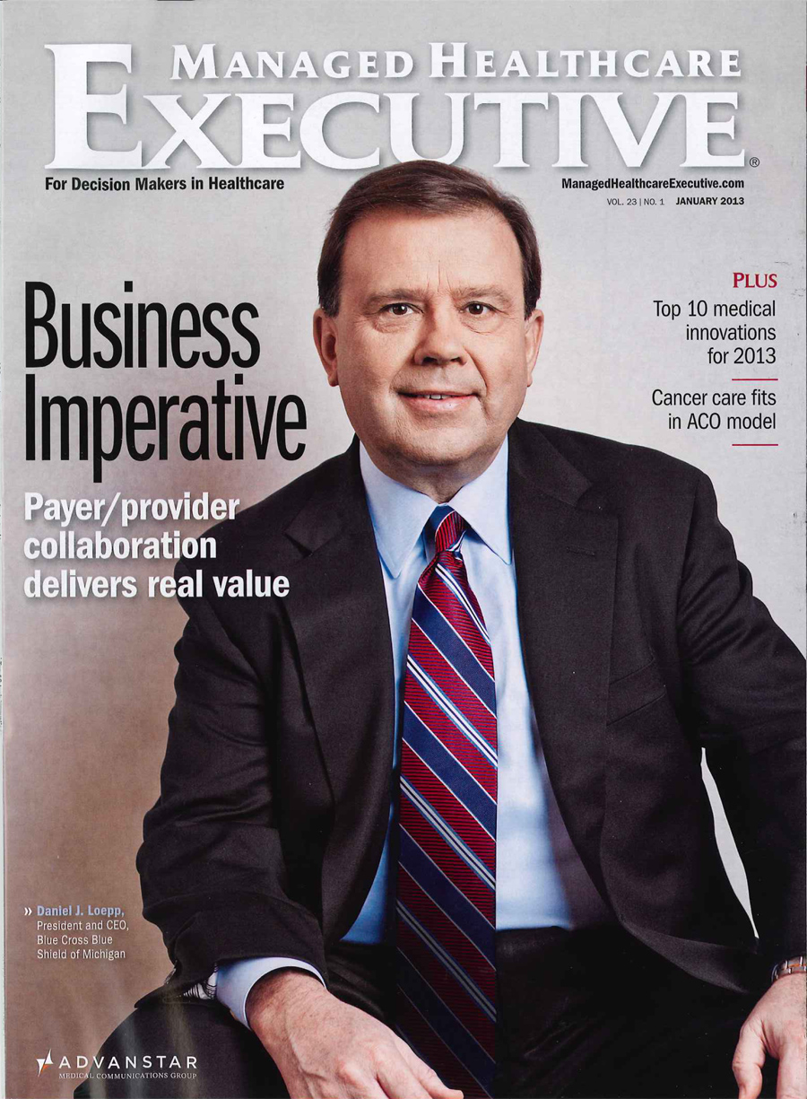
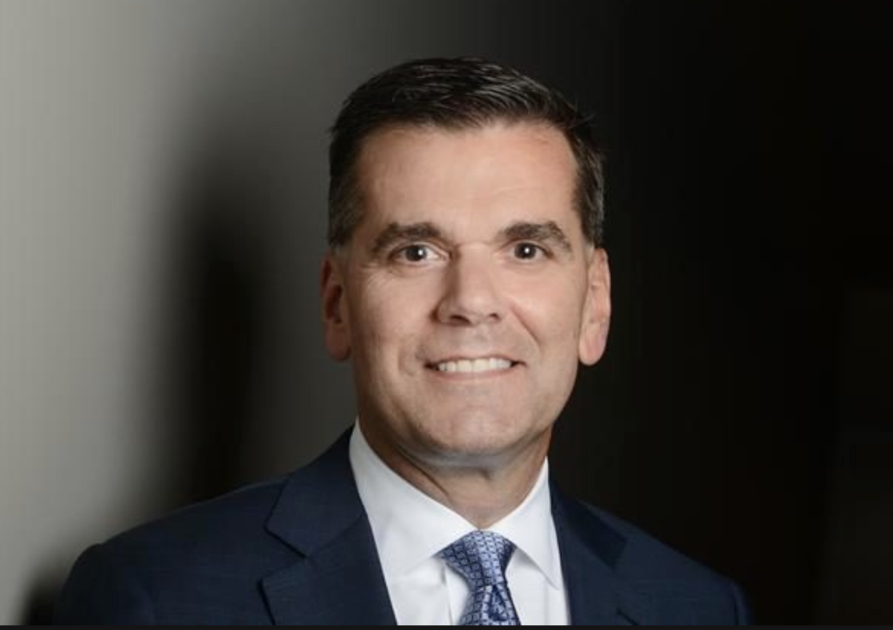
Top health insurance CEOs and their compensation in 2018
Mark Bertolini, CEO of Aetna:
$58.75 Million
David Wichmann, CEO of United Health:
$83.2 Million
Dan Loepp, CEO of Blue Cross Blue Shield Michigan:
$19 Million / year
Notes:
1. Note that Loepp has gotten a huge raise each of the last two years; his salary has jumped up from $3 million to $19 in two years.

Slide 8
The Solution: Single Payer Universal Healthcare
“Improved and Expanded Medicare for All”

Slide 9
The Solution: Single Payer Universal Healthcare
“Improved and Expanded Medicare for All”
US House: HR 1384 (Pramila Jayapal)
US Senate: SB 1804 (Bernie Sanders)
Michigan House of Representatives: HB6285 (Yousef Rabhi)

Slide 10
The Solution: Single Payer Universal Healthcare
“Improved and Expanded Medicare for All”
All residents automatically enrolled
No co-pays, premiums, deductibles or other out of pocket costs
Coverage = Medicare + vision, dental, and hearing
Long term elder and disability care
Transportation

Slide 11
The Solution: Single Payer Universal Healthcare
“Improved and Expanded Medicare for All”
All residents automatically enrolled
No co-pays, premiums, deductibles or other out of pocket costs
Coverage = Medicare + vision, dental, and hearing
Long term elder and disability care
Transportation
Cost containment: “global budgeting” (Jayapal—already in place in Maryland)

Slide 12
The Solution: Single Payer Universal Healthcare
“Improved and Expanded Medicare for All”
Role of Private Health Insurance:
No duplication of service
Private health companies can offer supplemental plans
Transition: 2 years (Jayapal); 4 years (Sanders)
2 years of salary replacement for displaced workers
Notes:
This is to prevent a higher-paying private system from undermining the public system, which would create one system for the rich and one for the rest of us.
A supplemental plan might be if Medicare will reimburse for 6 chiropractic visits a year, but you have a history of back problems, you might want to buy a supplemental plan that includes additional chiropractic visits. Or it could be for non-essential procedures, like cosmetic surgery, botox etc.
On the issue of displaced workers: 2 years of paid time off is not a bad consolation prize. Most industries that are shrunk or eliminated are done so by the decisions that governments make. For example, Amazon pays no sales tax, that is part of how it has been allowed to put most bookstores out of business. No one cared when Borders when out of business, no one gave those workers 2 years of salary replacement, they were just out on their ass.

Slide 13
The Solution: Single Payer Universal Healthcare
FUNDING: “How’re you gonna pay for it?”

Slide 14
The Solution: Single Payer Universal Healthcare
FUNDING: “How’re you gonna pay for it?”
Right now, US spends ~$3 trillion on healthcare
60% of that is already single payer ($1.88 trillion/yr) (Source: American Journal of Managed Care )
Where to find the other $1.12 trillion/yr?
That $1.12 trillion/yr is NOT NEW SPENDING: we are ALREADY SPENDING IT

Slide 15
WE ARE ALREADY SPENDING THIS MONEY. IT IS NOT NEW SPENDING. WE ARE JUST RE-ROUTING IT:
INSTEAD OF PAYING IT IN PREMIUMS AND DEDUCTIBLES TO OUR PRIVATE HEALTH INSURANCE COMPANIES, WITH SINGLE PAYER WE WILL BE PAYING IT IN TAXES TO THE GOVERNMENT
Notes:
EMPHASIZE THIS! AND SAY IT WILL SAVE ALMOST ALL OF US MONEY

Slide 16
The Solution: Single Payer Universal Healthcare
FUNDING: “How’re you gonna pay for it?”
Efficiency savings and cost reduction:
Amount saved over 10 years: $5 trillion (Source: PERI Umass-Amherst)
4.5% household premium above $29k in income (Source: Bernie Sanders)
Amount raised over 10 years: $3.5 trillion
Will save average family ~$4000 / year in out of pocket costs
7.5 % income tax on employers after 1st $2 million in earnings
Amount raised over 10 years: $3.9 trillion
Will save employers $9000 per employee/yr

Slide 17
SINGLE PAYER MEDICARE FOR ALL WILL SAVE THE US BETWEEN $2 AND $5 TRILLION OVER THE NEXT DECADE
Notes:
Note here that this is based on the Mercatus study ($2 trillion, this is the right wing estimate) and the PERI Umass study (This is $5 trillion, the left wing study)-– but note also that even if we don’t get as much savings from cutting reimbursements, eg and we end up breaking even, we still come out ahead as a country because it is the moral and the humane and the right thing to do

Slide 18
The Solution: Single Payer Universal Healthcare
Pros
Every provider “In-network” – more freedom to choose providers, more competition between providers
Unions will no longer have to choose between wages and health benefits
Ending “job lock” = more entrepreneurship
Gender justice = easier for women to leave abusive relationships

Slide 19
The Solution: Single Payer Universal Healthcare
Pros:
Lower auto insurance: up to 60% reduction in Michigan
Lower homeowners’ insurance and all forms of general liability insurance; workman’s comp, malpractice insurance (will end ambulance chasing)
Lower tuition, finance, and even prices
Doctors can focus on medicine again (40% of time, $80k/year on insurance)
Peace of mind: losing or changing jobs won’t be such a catastrophe anymore

Slide 20
Summary:
US health system is far too expensive and inefficient
Out of pocket prices are skyrocketing and crushing working and middle class families
Medicare for All would save most Americans money, and save the country money
Private health insurance is a big part of the problem, and should be phased out
Medicare for All is politically popular, and can be passed despite the filibuster if the Democratic party is united

Slide 21
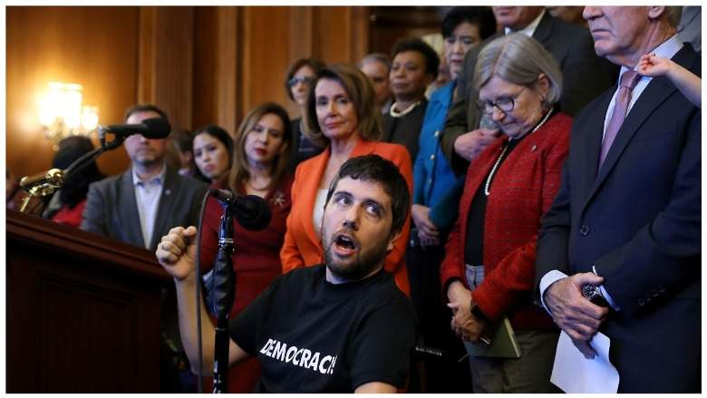
"Any proposal that maintains financial barriers to care — any proposal that continues to charge patients exorbitant copays, deductibles, and premiums — will necessarily leave people out. Any proposal that maintains the for-profit health insurance system will require that some people don’t get the healthcare they need." --Ady Barkan, single payer activist and ALS sufferer, testifying before congress April 30, 2019

