Slide 1
Why we need Single Payer Medicare for All Now
www.michigan4singlepayer.org
https://www.facebook.com/M4SPH/
https://twitter.com/Medicare4AllMI

Slide 3
The Vision:
A country in which all people can get the care they need regardless of how much money they have, or do not have, as a right.

Slide 4
The Problem

Slide 5
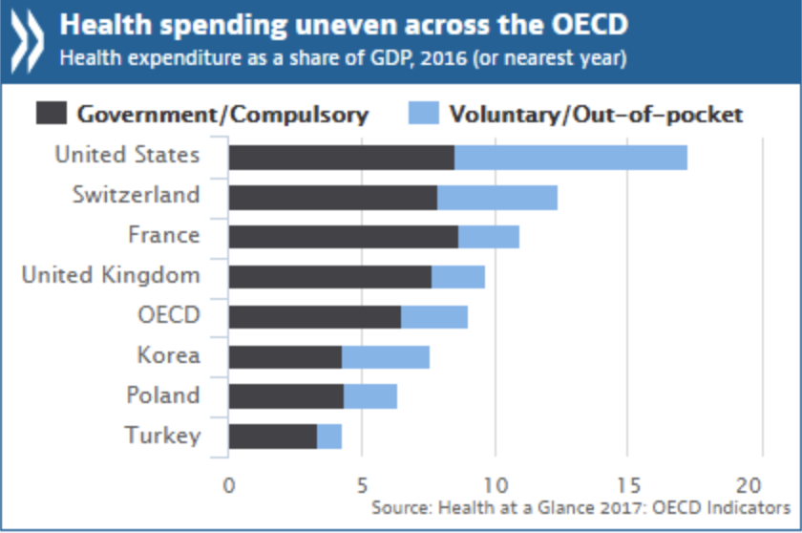
The Problem
The US spends far more than other industrialized countries on healthcare

Slide 6
The Problem
The US spends far more than other industrialized countries on healthcare
But has far worse outcomes:

Slide 9
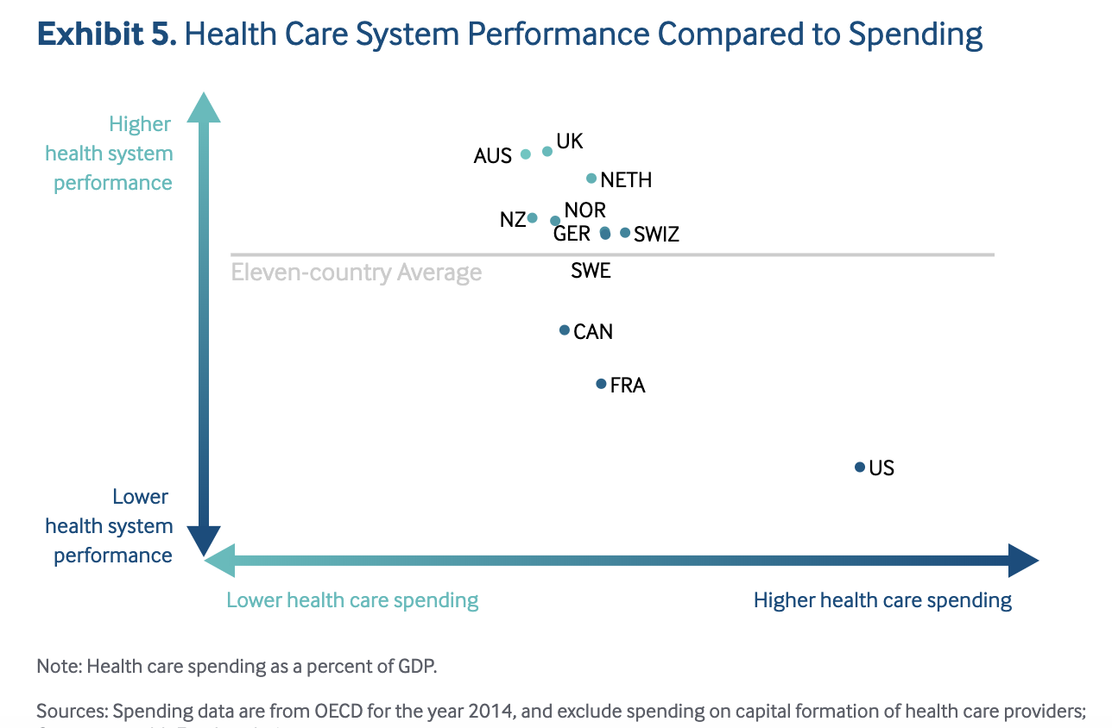
Source: Commonwealth Fund https://interactives.commonwealthfund.org/2017/july/mirror-mirror/

Slide 10
The Problem
The US is the only industrialized country without guaranteed universal healthcare of some kind.

Slide 11
We are behind all of the industrialized world, and much of the developing world, in not having universal healthcare:
Notes:
Green is universal healthcare free or low cost at the point of service; blue is free for some of the population; red is no universal healthcare

Slide 12
The Problem
Despite the ACA, 30 million Americans still uninsured (Source: Kaiser Family Foundation)

Slide 13
The Problem
Despite the ACA, 30 million Americans still uninsured (Source: Kaiser Family Foundation)
45,000 people a year die in the US due to lack of insurance (Source: Harvard Gazette)

Slide 14
The Problem
Despite the ACA, 30 million Americans still uninsured (Source: Kaiser Family Foundation)
45,000 people a year die in the US due to lack of insurance (Source: Harvard Gazette)
Another 41 million are underinsured (cannot afford to use their insurance) (Source: Commonwealth Fund)

Slide 15
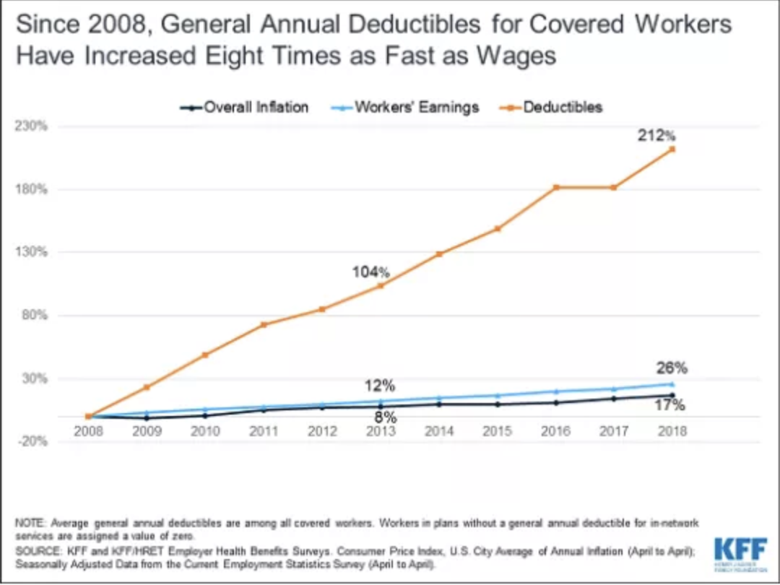
The Problem
Another 41 million are underinsured (cannot afford to use their insurance) (Source: Commonwealth Fund)
Average Deductible now: $1350 (up 212% since 2008)
Notes:
1. This is 8 times faster than wages have risen.
2. Remind audience: a deductible is the amount you have to personally pay before your insurance kicks in.

Slide 16
The Problem
Average Deductible now: $1350 (up 212% since 2008)
40% of Americans do not have $400 to pay for an unexpected expense (source: U.S. Federal Reserve)
61% of Americans could not cover $1000 in unexpected medical bills (Source: Bankrate Financial Security Index)
Notes:
R

Slide 17
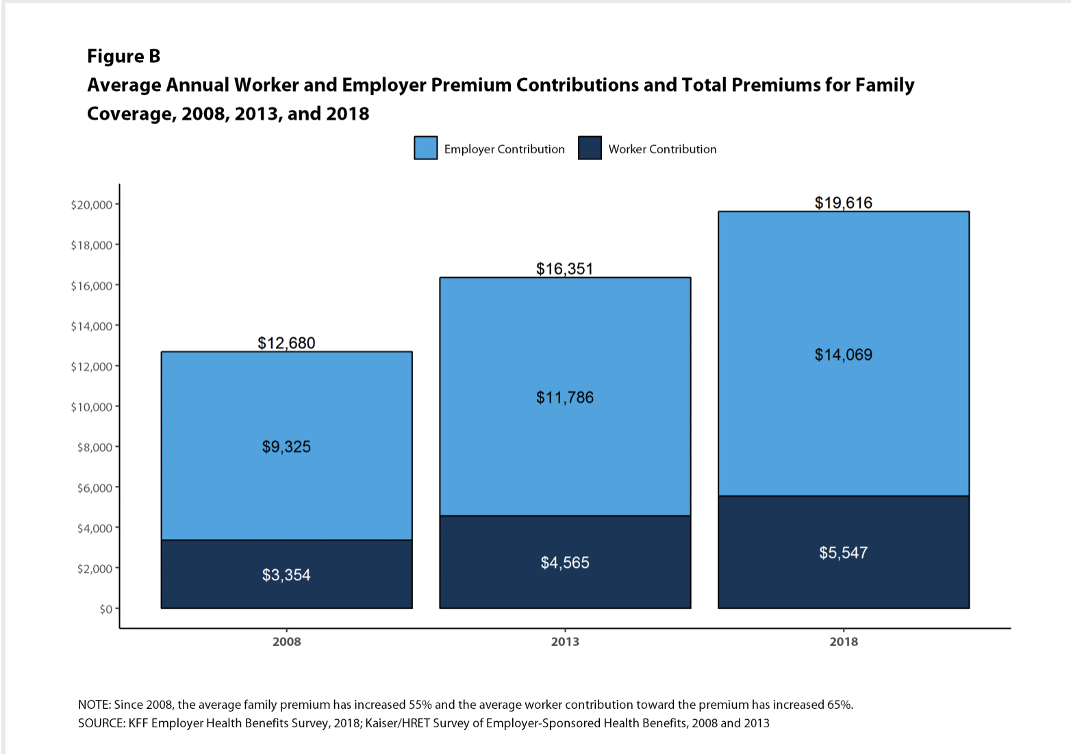
The Problem
Premiums have also risen astronomically
Notes:
1. Reminder: premiums are what you pay monthly to remain insured. These are in addition to the deductible.
2. This is a 55% rise in out of pocket costs for families since 2008; the percentage paid by employers is also declining
3 This is for employer-sponsored health insurance, where the employer pays some of the costs. For self-insured, small businesspeople, consultants, etc. they have to pay the entire $20,000 on their own.

Slide 18
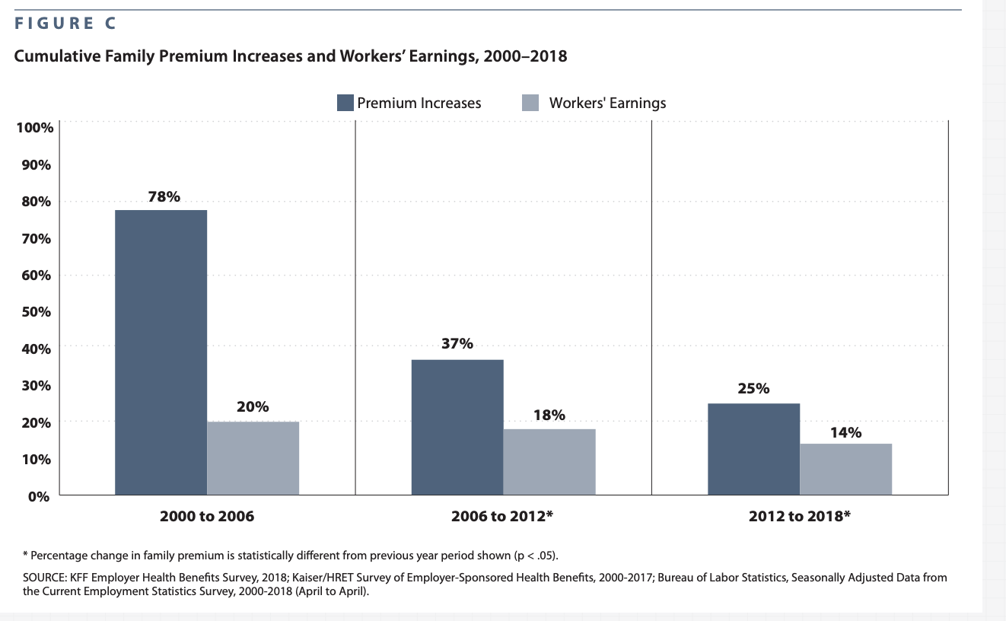
The Problem
Premiums have also risen astronomically—in comparison to wages
Notes:
1. Reminder: premiums are what you pay monthly to remain insured. These are in addition to the deductible.
2. This is a 55% rise in out of pocket costs for families since 2008; the percentage paid by employers is also declining
3 This is for employer-sponsored health insurance, where the employer pays some of the costs. For self-insured, small businesspeople, consultants, etc. they have to pay the entire $20,000 on their own.

Slide 19
The Problem
Premiums have also risen astronomically—in comparison to wages
Median income in Michigan: $55,000
Notes:
So, if someone is paying over $20k out of pocket and. Making $55k a year, that is basically completely unsustainable.

Slide 20
The Problem
67% of bankruptcies are due to medical bills (source: American Journal of Health Policy)
~1 million Americans a year (source: Kaiser Family Foundation)
Notes:
1. Note that not only has the ACA not changed this, this percentage has gone up slightly since the ACA went into effect

Slide 21
The Problem
67% of bankruptcies are due to medical bills (source: American Journal of Health Policy)
~1 million Americans a year (source: Kaiser Family Foundation)
25% of Americans struggle to pay medical bills (including 20% of insured Americans)
Notes:
1. Note that not only has the ACA not changed this, this percentage has gone up slightly since the ACA went into effect

Slide 22
The Problem
67% of bankruptcies are due to medical bills (source: American Journal of Health Policy)
~1 million Americans a year (source: Kaiser Family Foundation)
25% of Americans struggle to pay medical bills (including 20% of insured Americans)
This happens in no other industrialized country

Slide 23
The Problem
42% of cancer patients lose all their assets within 2 years of diagnosis (Source: American Journal of Medicine)

Slide 24
The Problem
42% of cancer patients lose all their assets within 2 years of diagnosis (Source: American Journal of Medicine)
Single largest category on GoFundMe is medical debt (over $1.5 billion / year) (Source: Business Insider)
Notes:
In an interview with KHN, GoFundMe CEO Rob Solomon made clear he is not thrilled about what this says for the U.S. health care system. Some highlights:
"I had no notion of how severe the problem is. You read about the debate about single-payer health care and all the issues, the partisan politics. What I really learned is the health care system in the United States is really broken. Way too many people fall through the cracks."
"The system is terrible … there are people who are not getting relief from us or from the institutions that are supposed to be there. We shouldn't be the solution to a complex set of systemic problems."

Slide 25
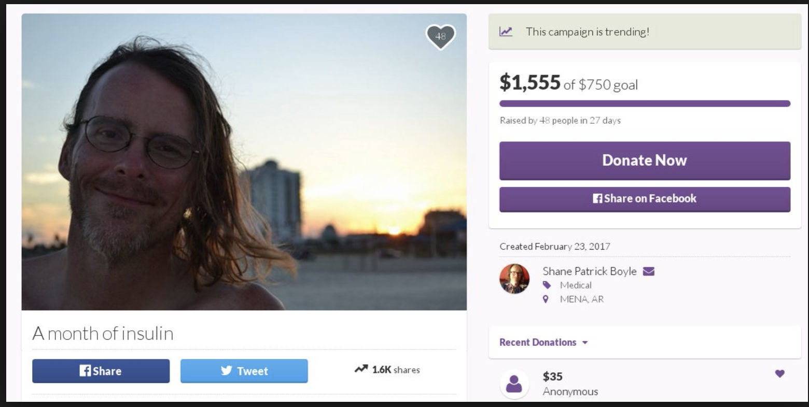
The Problem
Single largest category on GoFundMe is medical debt (over $1.5 billion / year) (Source: Business Insider)
Notes:
This is Shane Patrick Boyle, who was not able to raise enough money on GoFundMe to pay for his insulin, which cost $1555 a month, and so he died in late 2017. Again, emphasize this happens no where else in the modern world.

Slide 26
The Problem
Health insurance companies: Part of the Problem
-20% avg. denial rate (source: Kaiser Family Foundation)
-60%-80% of these are overturned on appeal (Source: California Nurses Association)
Notes:
Some companies are notorious for much higher denial rates, as much as 40%
The fact that so many were overturned shows that they were wrongful denials in the first place. But often it takes huge resources of time and often money to get an appeal before an independent regulatory body, such as the state insurance commission. Many people who are sick, in pain, poor etc. or simply don’t know their rights do not appeal.

Slide 27
What insurance company denials look like
Notes:
Make sure to read out the amounts on this bill. Note stories you’ve heard of, note to everyone that many have heard stories or had this happen to them.

Slide 28
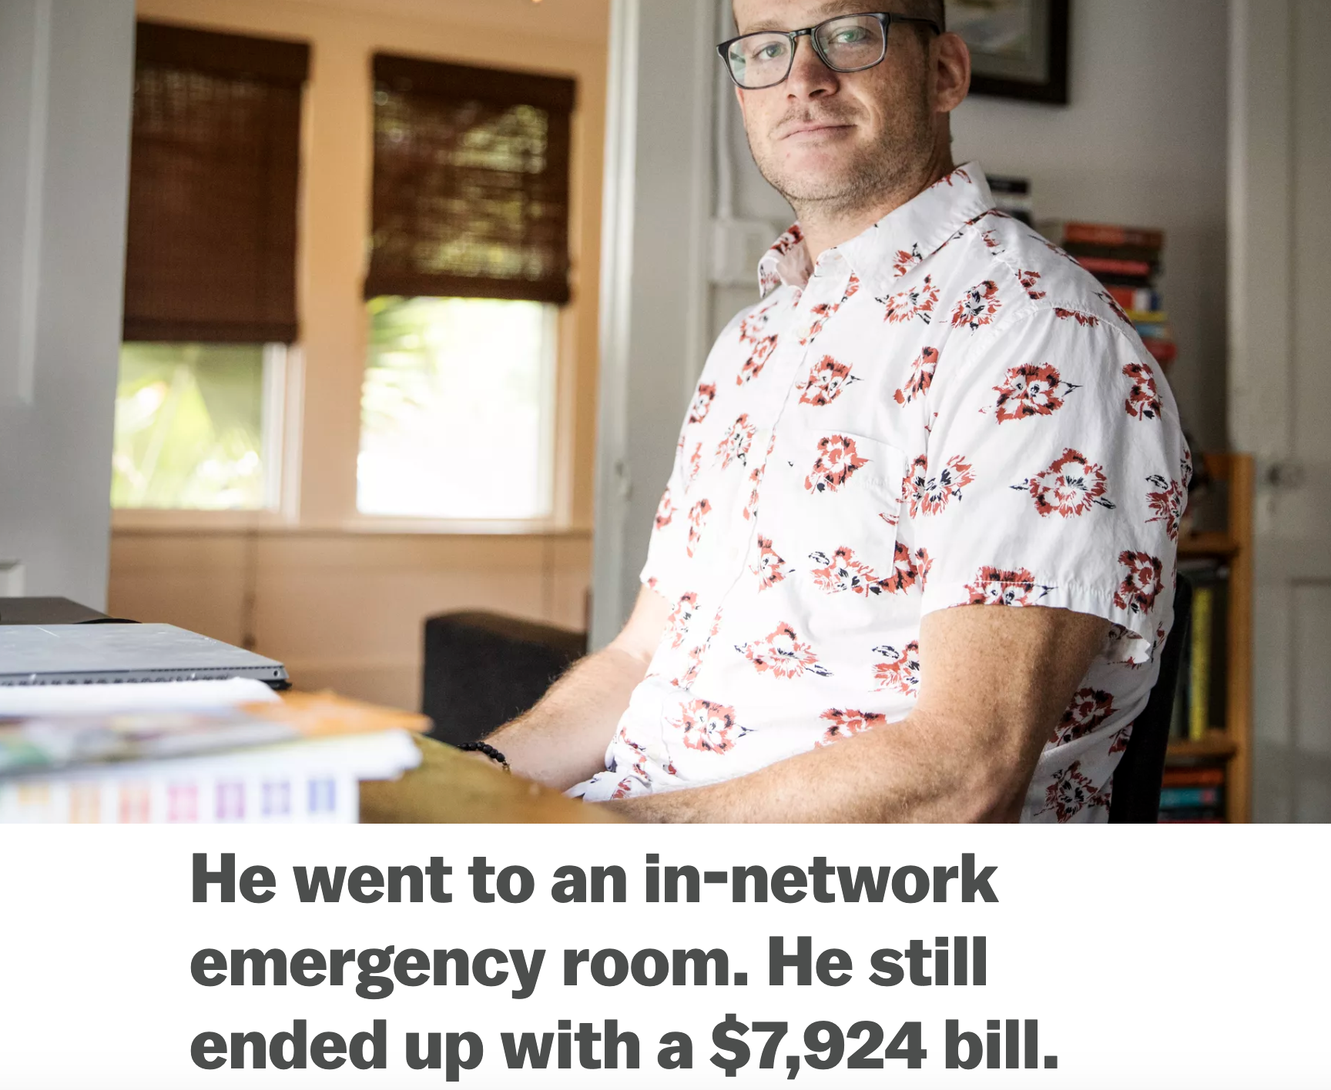
Insurance companies routinely deny payment for routine ER visits, and ERs routinely charge outrageous amounts for routine procedures
Source: Sarah Kliff, Vox.com

Slide 29
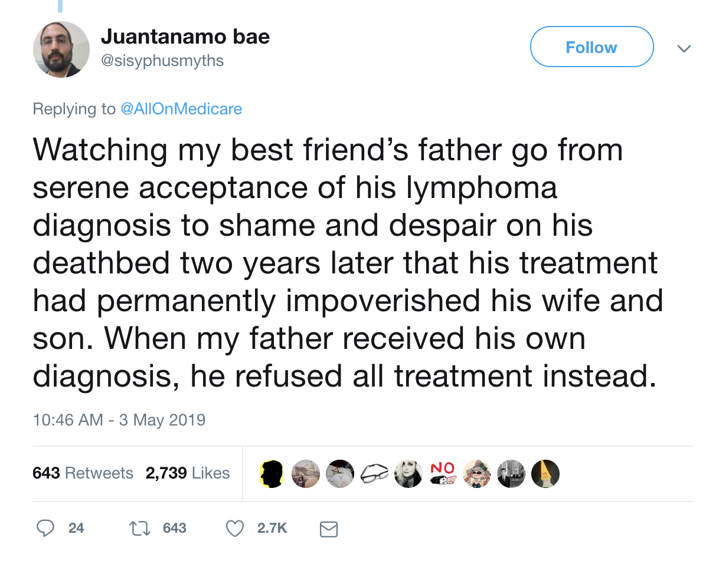
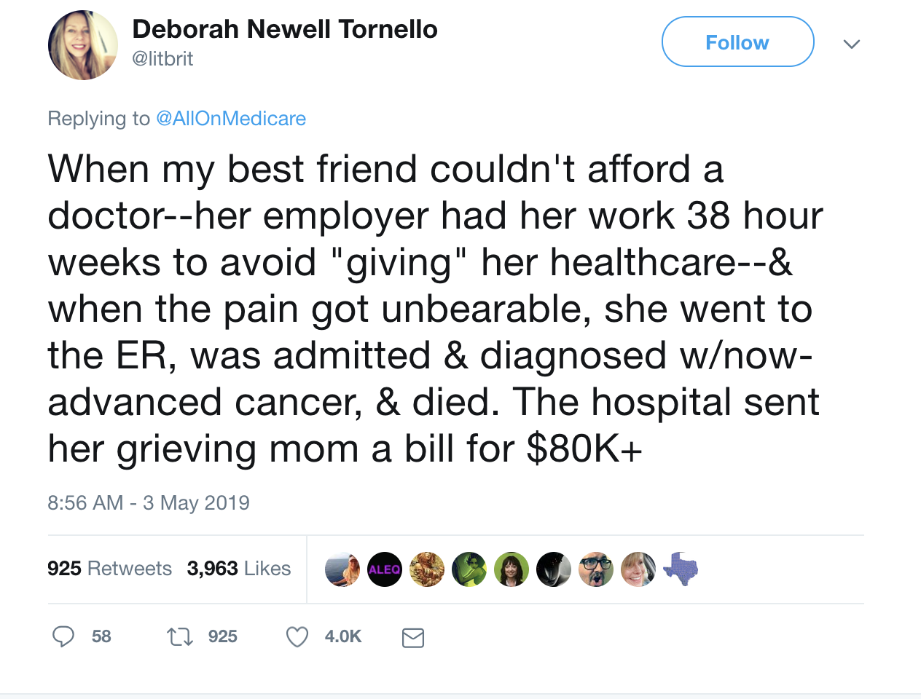
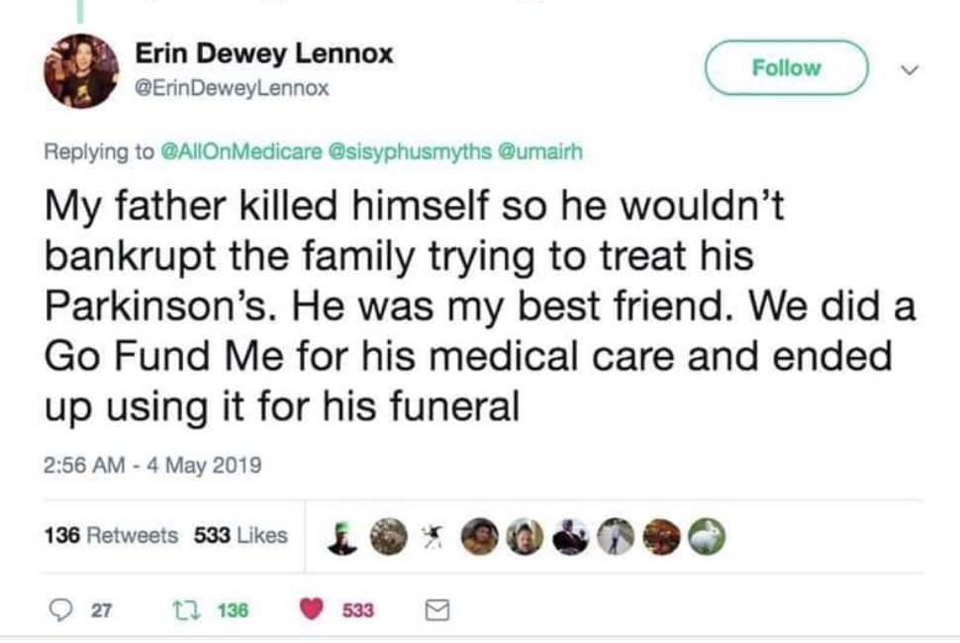

Slide 30
The Problem
Health insurance companies: Part of the Problem
-20% avg. denial rate (source: Kaiser Family Foundation)
-60%-80% of these are overturned on appeal (Source: California Nurses Association)
Health insurance does not work as a business model without routine denials. Denials kill and bankrupt people.
Notes:
This is REALLY IMPORTANT – health insurance does not make sense as a business model. Insurance cannot work if all of the people paying in also need a pay out. Auto insurance would never work if everyone in the insurance pool was going to get into a car wreck every year. Some with homeowners. The ONLY way that health insurance can work is if companies do NOT pay out, when you need them too.
Note that health insurance is a relatively NEW phenomenon, of the 20th century, and employer sponsored health benefits are even more recent, dating to about WWII, within the lifetime of many. Thus, they can be ended. It’s not like this system has been around for ever and ever. It had its time, it is outdated, now and needs to go.

Slide 31
The Problem
Health insurance companies: Part of the Problem
-20% avg. denial rate (source: Kaiser Family Foundation)
-60%-80% of these are overturned on appeal (Source: California Nurses Association)
-Private health insurance spends 31% of revenue on administration, compared with less than 2% by Medicare (Source: Becker’s Hospital Review)

Slide 32
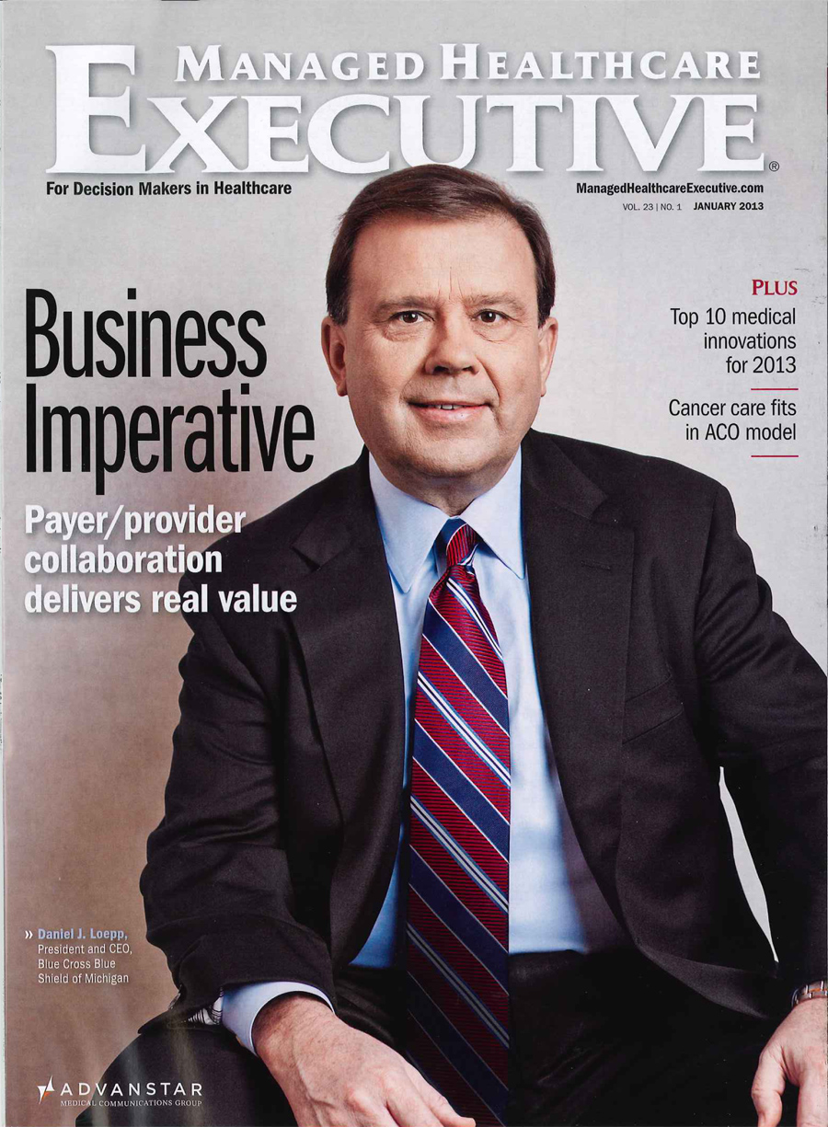
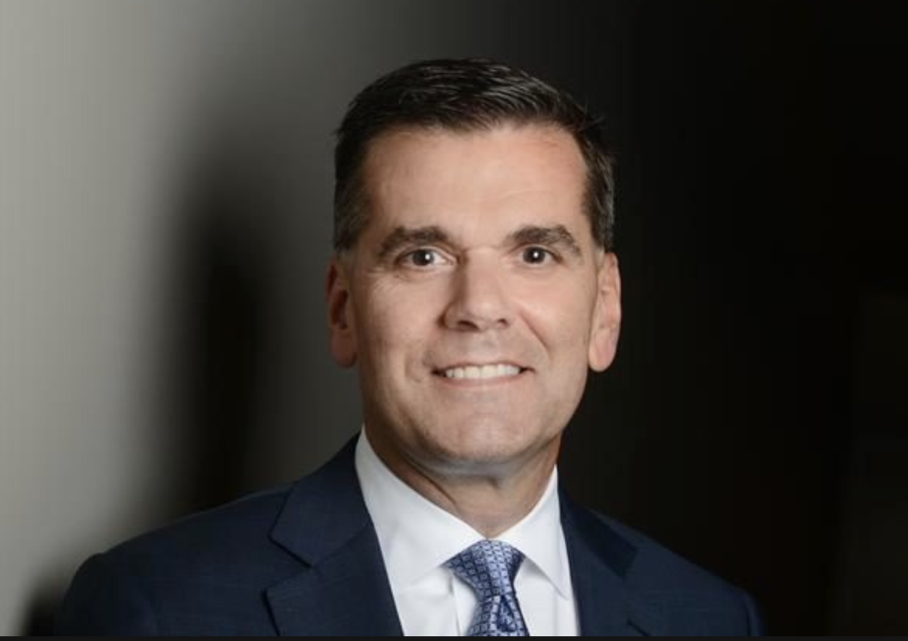
Top health insurance CEOs and their compensation in 2018
Mark Bertolini, CEO of Aetna:
$58.75 Million
David Wichmann, CEO of United Health:
$83.2 Million
Dan Loepp, CEO of Blue Cross Blue Shield Michigan:
$19 Million / year
Notes:
1. Note that Loepp has gotten a huge raise each of the last two years; his salary has jumped up from $3 million to $19 in two years.

Slide 33
The Problem
Health insurance companies: Part of the Problem
-Doctors spend twice as much time dealing with insurance companies than with patients, and insurance denials and paperwork costs them on average $80,000 / year (1/3 of all their income) (Source: American College of Physicians)
Notes:
You can also add that there is a 25% burnout rate because doctors are so sick of spending most of their time and money fighting insurance companies.
You can also add that most hospitals have entire departments devoted just to dealing with insurance companies.

Slide 34
The Problem
Uninsured camping out to get once a year free dental, vision and health care in Appalachia
Notes:
Make it clear all these people could be covered by the combined salaries of those first two CEOs.
Just leave this image in people’s minds as the one image of our fucked up healthcare system.

Slide 35
The Problem

Slide 36
The Solution: Single Payer Universal Healthcare
“Improved and Expanded Medicare for All”

Slide 37
The Solution: Single Payer Universal Healthcare
“Improved and Expanded Medicare for All”
US House: HR 1384 (Pramila Jayapal)
US Senate: SB 1804 (Bernie Sanders)
Michigan House of Representatives: HB6285 (Yousef Rabhi)

Slide 38
The Solution: Single Payer Universal Healthcare
“Improved and Expanded Medicare for All”
How it works:
All residents automatically enrolled
No co-pays, premiums, deductibles or other out of pocket costs

Slide 39
The Solution: Single Payer Universal Healthcare
“Improved and Expanded Medicare for All”
All residents automatically enrolled
No co-pays, premiums, deductibles or other out of pocket costs
Coverage = Medicare + vision, dental and long-term care

Slide 40
The Solution: Single Payer Universal Healthcare
“Improved and Expanded Medicare for All”
All residents automatically enrolled
No co-pays, premiums, deductibles or other out of pocket costs
Coverage = Medicare + vision, dental and long-term care

Slide 41
The Solution: Single Payer Universal Healthcare
“Improved and Expanded Medicare for All”
All residents automatically enrolled
No co-pays, premiums, deductibles or other out of pocket costs
Coverage = Medicare + vision, dental, and hearing
Long term elder and disability care
Transportation

Slide 42
The Solution: Single Payer Universal Healthcare
“Improved and Expanded Medicare for All”
Cost controls:
Reimbursement at Medicare rates
Global budgeting (Jayapal bill)
Negotiating with pharmaceutical companies
Notes:
Global budgeting means HHS and Medicare will set a budget for each hospital or clinic, and that is the amount they have to work with. It is their job to keep expenses down and focus only on medical care. Sanders does not include this in his bill.
In both bills, the HHS has the power to revoke patents if a company refuses to negotiate on a drug price, and give them to a generic maker or a competitor.

Slide 43
The Solution: Single Payer Universal Healthcare
“Improved and Expanded Medicare for All”
Role of Private Health Insurance:
No duplication of service
Private health companies can offer supplemental plans
Transition: 2 years (Jayapal); 4 years (Sanders)
2/5 years of salary replacement for displaced workers
Notes:
This is to prevent a higher-paying private system from undermining the public system, which would create one system for the rich and one for the rest of us.
A supplemental plan might be if Medicare will reimburse for 6 chiropractic visits a year, but you have a history of back problems, you might want to buy a supplemental plan that includes additional chiropractic visits. Or it could be for non-essential procedures, like cosmetic surgery, botox etc.
On the issue of displaced workers: 2 years of paid time off is not a bad consolation prize. Most industries that are shrunk or eliminated are done so by the decisions that governments make. For example, Amazon pays no sales tax, that is part of how it has been allowed to put most bookstores out of business. No one cared when Borders when out of business, no one gave those workers 2 years of salary replacement, they were just out on their ass.

Slide 44
The Solution: Single Payer Universal Healthcare
FUNDING: “How’re you gonna pay for it?”

Slide 45
The Solution: Single Payer Universal Healthcare
FUNDING: “How’re you gonna pay for it?”
Right now, US spends ~$3 trillion on healthcare

Slide 46
The Solution: Single Payer Universal Healthcare
FUNDING: “How’re you gonna pay for it?”
Right now, US spends ~$3 trillion on healthcare
60% of that is already single payer ($1.88 trillion/yr) (Source: American Journal of Managed Care )
Where to find the other $1.12 trillion/yr? (or $11.2 trillion over 10 years)??
Notes:
1. It’s already single payer because it includes Medicare, Medicaid, CHiP, VA, Tricare, and Indian Health

Slide 47
The Solution: Single Payer Universal Healthcare
FUNDING: “How’re you gonna pay for it?”
Right now, US spends ~$3 trillion on healthcare
60% of that is already single payer ($1.88 trillion/yr) (Source: American Journal of Managed Care )
Where to find the other $1.12 trillion/yr?
That $1.12 trillion/yr is NOT NEW SPENDING: we are ALREADY SPENDING IT

Slide 48
WE ARE ALREADY SPENDING THIS MONEY. IT IS NOT NEW SPENDING. WE ARE JUST RE-ROUTING IT:
INSTEAD OF PAYING IT IN PREMIUMS AND DEDUCTIBLES TO OUR PRIVATE HEALTH INSURANCE COMPANIES, WITH SINGLE PAYER WE WILL BE PAYING IT IN TAXES TO THE GOVERNMENT
Notes:
EMPHASIZE THIS! AND SAY IT WILL SAVE ALMOST ALL OF US MONEY

Slide 49
The Solution: Single Payer Universal Healthcare
FUNDING: “How’re you gonna pay for it?”
Right now, US spends ~$3 trillion on healthcare
60% of that is already single payer ($1.88 trillion/yr) (Source: American Journal of Managed Care )
Where to find the other $1.12 trillion/yr?
~$500 billion through efficiency savings and cost reduction (Source: PERI Umass-Amherst)
4.5% household premium above $29k in income (Source: Bernie Sanders)
Amount raised over 10 years: $3.5 trillion
Will save average family ~$4000 / year in out of pocket costs

Slide 50
The Solution: Single Payer Universal Healthcare
FUNDING: “How’re you gonna pay for it?”
~$500 billion through efficiency savings and cost reduction (Source: PERI Umass-Amherst)
4.5% household premium above $29k in income (Source: Bernie Sanders)
Amount raised over 10 years: $3.5 trillion
Will save average family ~$4000 / year in out of pocket costs
7.5 % income tax on employers after 1st $2 million in earnings
Amount raised over 10 years: $3.9 trillion
Will save employers $9000 per employee/yr

Slide 51
The Solution: Single Payer Universal Healthcare
FUNDING: “How’re you gonna pay for it?”
4.5% household premium above $29k in income (Source: Bernie Sanders)
Amount raised over 10 years: $3.5 trillion
Will save average family ~$4000 / year in out of pocket costs
7.5 % income tax on employers after 1st $2 million in earnings
Amount raised over 10 years: $3.9 trillion
Will save employers $9000 per employee/yr
Other options:

Slide 52
The Solution: Single Payer Universal Healthcare
FUNDING: “How’re you gonna pay for it?”
4.5% household premium above $29k in income (Source: Bernie Sanders)
Amount raised over 10 years: $3.5 trillion
Will save average family ~$4000 / year in out of pocket costs
7.5 % income tax on employers after 1st $2 million in earnings
Amount raised over 10 years: $3.9 trillion
Will save employers $9000 per employee/yr
Other options:
Closing tax loopholes, like the employer health insurance tax break
Amount raised over 10 years: $4.2 trillion

Slide 53
The Solution: Single Payer Universal Healthcare
FUNDING: “How’re you gonna pay for it?”
Other options:
Closing tax loopholes, like the employer health insurance tax break
Amount raised over 10 years: $4.2 trillion
Raising top marginal tax rates to 52% over $10 million
Amount raised over 10 years: $1.8 trillion
1% wealth tax on wealth over $21 million
Amount raised over 10 years: $1.3 trillion

Slide 54
The Solution: Single Payer Universal Healthcare
FUNDING: “How’re you gonna pay for it?”
$0.5T + $3.5T + $3.9T + $4.2T = $12.1 T (i.e., more than enough)

Slide 55
The Solution: Single Payer Universal Healthcare
FUNDING: “How’re you gonna pay for it?”
“We can’t afford single payer Medicare for All!”

Slide 56
The Solution: Single Payer Universal Healthcare
FUNDING: “How’re you gonna pay for it?”
“We can’t afford single payer Medicare for All!”
Actually: We can’t afford NOT to have single payer Medicare for All:

Slide 57
The Solution: Single Payer Universal Healthcare
FUNDING: “How’re you gonna pay for it?”
“We can’t afford single payer Medicare for All!”
Actually: We can’t afford NOT to have single payer Medicare for All:
Projected spending per year by 2027 (if nothing changes): $6 trillion / year
Medicare for All will save us money personally and as a country

Slide 58
SINGLE PAYER MEDICARE FOR ALL WILL SAVE THE US BETWEEN $2 AND $5 TRILLION OVER THE NEXT DECADE

Slide 59
SINGLE PAYER MEDICARE FOR ALL WILL SAVE THE US BETWEEN $2 AND $5 TRILLION OVER THE NEXT DECADE (Source:Mercatus institute / PERI U-Mass Amherst)
WE COULD FIX EVERY ROAD AND BRIDGE OR SEND EVERY AMERICAN TO COLLEGE FOR DECADES WITH THAT MUCH MONEY (Source: American Society of Civil Engineers / Senator Bernie Sanders

Slide 60
The Solution: Single Payer Universal Healthcare
How will it get passed?

Slide 61
The Solution: Single Payer Universal Healthcare
How will it get passed?
Democratic House, Senate + Presidency
Ending filibuster / using parliamentary loophole for “reconciliation”
Notes:
This is technical, but important: At most a democratic president in 2020 will have 50 or 51 votes in the senate. 60 is needed to break a filibuster. Democrats could get around this by abolishing the filibuster, which has already been abolished by Republicans for supreme court votes; they could also use a legal loophole called “reconciliation.” Reconciliation only requires 51 votes. Reconciliation is only supposed to be for strictly budgetary concerns, not legislation as big and broad as Medicare for All. But the Vice President is technically the “President of the Senate” and can overrule anything the Senate parliamentarian (the official who interprets the rules for the Senate). As long as the Vice President says it’s ok to use reconciliation, it will be.

Slide 62
The Solution: Single Payer Universal Healthcare
How will it get passed?
2020 Presidential candidates who have cosponsored Sanders bill:
Sanders
Gillibrand (coauthor)
Warren
Harris
Booker
Notes:
Tulsi Gabbard has cosponsored the Pramila Jayapal bill; Andrew Yang is in favor of both bills

Slide 63
The Solution: Single Payer Universal Healthcare
How will it get passed?
Polling: Support for Medicare for All as of 2018:
Democrats: 85%
Independents: 70%
Republicans: 52%
AMERICANS TOTAL: 70%
Notes:
Some will bring up a KFF poll that shows support dropping when people are told they’ll lose their employer sponsored insurance or that their taxes will go up. But this poll did not accurately reflect the real situation: that their taxes will be a lot less than what they pay in premiums now; and that they’ll get all the same benefits as their employer plan but for no out of pocket costs

Slide 64
The Solution: Single Payer Universal Healthcare
Pros of passing Single Payer Medicare for All:
Notes:
Some will bring up a KFF poll that shows support dropping when people are told they’ll lose their employer sponsored insurance or that their taxes will go up. But this poll did not accurately reflect the real situation: that their taxes will be a lot less than what they pay in premiums now; and that they’ll get all the same benefits as their employer plan but for no out of pocket costs

Slide 65
The Solution: Single Payer Universal Healthcare
Pros of passing Single Payer Medicare for All:
Every provider “In-network” – more freedom to choose providers, more competition between providers

Slide 66
The Solution: Single Payer Universal Healthcare
Pros of passing Single Payer Medicare for All:
Every provider “In-network” – more freedom to choose providers, more competition between providers
Unions will no longer have to choose between wages and health benefits

Slide 67
The Solution: Single Payer Universal Healthcare
Pros of passing Single Payer Medicare for All:
Every provider “In-network” – more freedom to choose providers, more competition between providers
Unions will no longer have to choose between wages and health benefits
Ending “job lock” = more entrepreneurship

Slide 68
The Solution: Single Payer Universal Healthcare
Pros of passing Single Payer Medicare for All:
Every provider “In-network” – more freedom to choose providers, more competition between providers
Unions will no longer have to choose between wages and health benefits
Ending “job lock” = more entrepreneurship
Gender justice = easier for women to leave abusive relationships

Slide 69
The Solution: Single Payer Universal Healthcare
Pros of passing Single Payer Medicare for All:
Auto insurance: up to 60% reduction in Michigan

Slide 70
The Solution: Single Payer Universal Healthcare
Pros of passing Single Payer Medicare for All:
Auto insurance: up to 60% reduction in Michigan
Lower homeowners’ insurance and all forms of general liability insurance; worker’s comp, malpractice insurance

Slide 71
The Solution: Single Payer Universal Healthcare
Pros of passing Single Payer Medicare for All:
Auto insurance: up to 60% reduction in Michigan
Lower homeowners’ insurance and all forms of general liability insurance; worker’s comp, malpractice insurance (will end ambulance chasing)

Slide 72
The Solution: Single Payer Universal Healthcare
Pros of passing Single Payer Medicare for All:
Auto insurance: up to 60% reduction in Michigan
Lower homeowners’ insurance and all forms of general liability insurance; worker’s comp, malpractice insurance (will end ambulance chasing)
Lower tuition, finance, and even prices

Slide 73
The Solution: Single Payer Universal Healthcare
Pros of passing Single Payer Medicare for All:
Auto insurance: up to 60% reduction in Michigan
Lower homeowners’ insurance and all forms of general liability insurance; worker’s comp, malpractice insurance (will end ambulance chasing)
Lower tuition, finance, and even prices
Doctors can focus on medicine again

Slide 74
The Solution: Single Payer Universal Healthcare
Pros of passing Single Payer Medicare for All:
Auto insurance: up to 60% reduction in Michigan
Lower homeowners’ insurance and all forms of general liability insurance; worker’s comp, malpractice insurance (will end ambulance chasing)
Lower tuition, finance, and even prices
Doctors can focus on medicine again
Peace of mind: losing or changing jobs won’t be such a catastrophe anymore

Slide 75
What about other paths to universal healthcare?

Slide 76
What about other paths to universal healthcare?
“Medicare buy-in at 50” (Debbie Stabenow)
Pros: Would help to lower premiums some.
Cons: What about people under 50? Especially millennials and Gen z, “gig economy”

Slide 77
What about other paths to universal healthcare?
“Medicare buy-in public option” (Pete Buttigieg)

Slide 78
What about other paths to universal healthcare?
“Medicare buy-in public option” (Pete Buttigieg)
Pros: available to everyone, will compete with private insurance to lower prices
Cons: almost half of Americans still cannot afford to ”buy” anything; leaves private health insurance intact which will compete against Medicare and undermine it, creating a two-tiered system

Slide 79
What about other paths to universal healthcare?
“Medicare for America” – (Center for American Progress, introduced by Rose DeLauro and Jan Shakowsky)
Pros: closest to true Medicare for All, may be more politically palatable
Does not ban duplicative private health insurance
Allows anyone to leave private health insurance for Medicare, deductibles capped at $350/ year, lower by income, no deductibles under 200% of Federal Poverty Level
Premiums capped at $5000/yr, lower by income
All newborns automatically enrolled; eventually will lead to Medicare for All
Cons:
Still creates a two-tiered system: not all doctors will take it
Misleading: ”You can keep your insurance if you like it” – not really true
Notes:
The last point is important. Under this plan, YOU can leave your employer plan if you want, but you don’t get to decide whether to keep it, your employer does. If your employer decides to dump their employees into Medicare and pay the alternative tax, you won’t get to stay on that plan. And it is expected that most employers will eventually do this very thing.

Slide 80
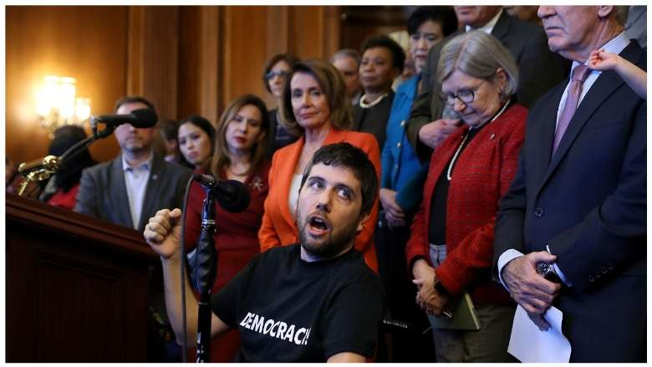
"Any proposal that maintains financial barriers to care — any proposal that continues to charge patients exorbitant copays, deductibles, and premiums — will necessarily leave people out. Any proposal that maintains the for-profit health insurance system will require that some people don’t get the healthcare they need." --Ady Barkan, single payer activist and ALS sufferer, testifying before congress April 30, 2019

Slide 81
Summary:
US health system is far too expensive and inefficient
Out of pocket prices are skyrocketing and crushing working and middle class families
Medicare for All would save most Americans money, and save the country money
Private health insurance is a big part of the problem, and should be phased out
Medicare for All is politically popular, and can be passed despite the filibuster if the Democratic party is united

